Slide 1
Year 4 Parent meeting
15.09.21

Slide 2
Reading expectations
Book bags will be sent home every day and will be changed on a Monday and a Thursday.
Please read with your children at home.

Slide 3
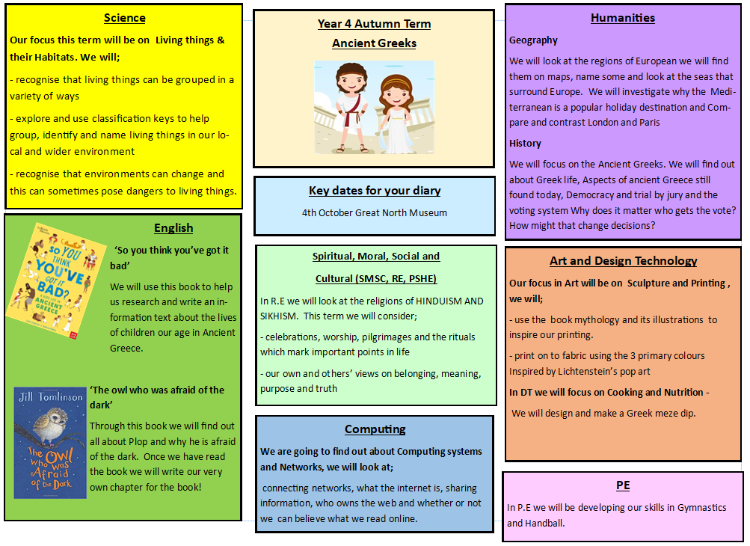

Slide 4
Homework
Every week your child will have a set of spellings to learn.
There will be a TTRockstars tournament between the Key Stage 2 classes.
https://ttrockstars.com/
A set of possible homework activities based around our topic will be available. The children can earn 20 learning points for every piece they choose to do, (please do no more than 6)
Seesaw

Slide 5
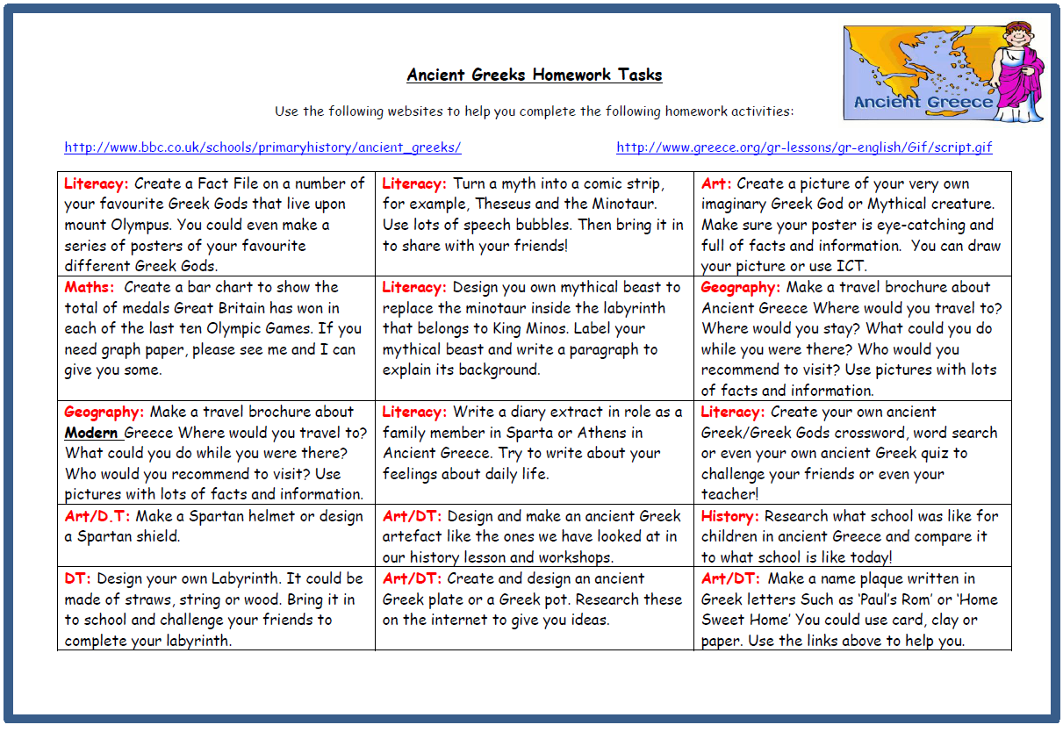
http://www.bbc.co.uk/schools/primaryhistory/ancient_greeks/
http://www.greece.org/gr-lessons/gr-english/Gif/script.gif

Slide 6
P.E
Our PE days are MONDAY and FRIDAY
No jewellery.
Trainers must be brought into school.

Slide 7
Reminders
Ping
School Website
School Twitter

Slide 8
Finally…
Attendance
Timings

