Slide 1
Year 1 Welcome Meeting

Slide 2
Year 1 Staff
Miss O'Neill
Mrs Ikhlaq
Mrs Hopper
Ms Downie

Slide 3
Year 1 Expectations
Attendance & Being on time:
It is important that your child comes to school everyday on time.
School gates open at 8:45am and close at 8:55am.
School finishes at 3:30pm.

Slide 4
Year 1 Expectations
PE:
Our PE days are Monday and Tuesday.
Your child will need to bring trainers into school for our outdoor PE lessons on a Tuesday.
No jewellery and earrings need to be removed.
Hair tied back.
Please ensure all your child’s clothes are labelled.

Slide 5
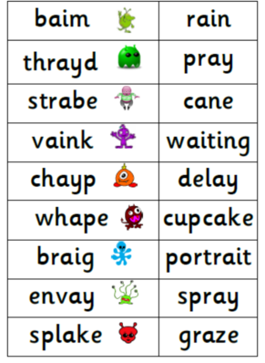
Year 1 Expectations
Phonics Screening Test:
Your child will be sitting their phonics screening check in June 2022.
The children will be tested on their ability to blend real and nonsense words.
It's not a formal test.
Their are 40 words and your child will read these to a teacher.

Slide 6
Year 1 Expectations
Homework – Reading:
Book bags will go home every night and these need to be returned to school on a daily basis.
Reading books will be changed on a Monday and Thursday. Please encourage your child to read at home.
They should have their reading record signed so it can be checked by their class teacher.
Encourage your child to read when you are out and about – signs and labels etc.

Slide 7
Year 1 Expectations
Homework:
Key words which we have been learning in class that week will be given to your child every Thursday. Please support your child to practise reading and writing these.
Handwriting sheets will also be given every Thursday. It is important children practise forming the letters to ensure correct formation. These do not need to be returned to school.

Slide 8
Year 1 Key Words

Slide 9
Topic Web

Slide 10
Please look at our class page on our school website.
I will keep it updated with information, examples of work and photographs about what your child has been learning.

Slide 11
Thank you so much for coming!
If you ever have any issues, questions or simply just want to see me please just ask.
Any questions?

Slide 12
