Slide 1
Year 6 Parent meeting
13th September 2021

Slide 2
Key information and dates
PE days are Wednesday and Thursday for this term – trainers are needed.
We have a trip to Newcastle Theatre Royal on the 24th September to see Kwame Alexander, a poet we will study in class.
The following Monday (the 27th) we will have a poetry workshop in school with Val Bloom.
Check the school website pages and twitter for regular updates about our work in class (@Hawthorn_PS)
If you ever have a question or concern, speak to us!

Slide 3
Reading
Reading bags will go home every night
Each child has a book to read – they should read every night to improve their skills.
If they want to read their own book from home, that is fine.
All reading should be recorded in their reading record.
Any other information we want to pass onto you will also be in their reading bags, so it is worth checking the bags frequently.

Slide 4
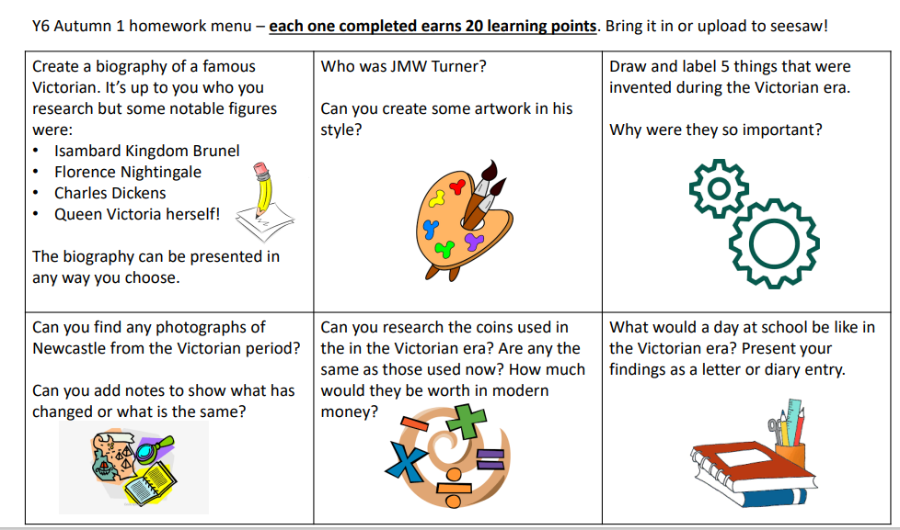
Homework
Children also have logins for TTRockstars to practise multiplication skills.
All children have been provided with a code to access seesaw at home.

Slide 5
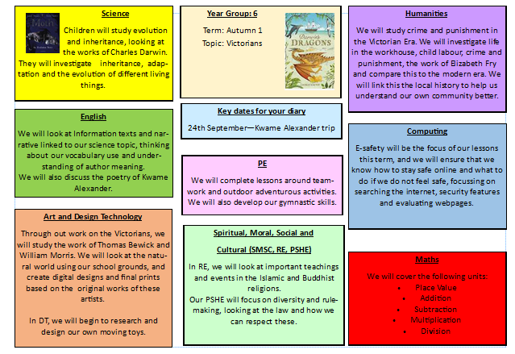
Our topic this half-term

Slide 6
SATs
SATs take place in May over the course of 4 days.
There are tests in reading, maths and grammar. I will also assess writing and give a level for this.
We are still receiving updates about SATs.
Nearer to the time, we will run a workshop to provide more information.

Slide 7
High School Application
Apply Online
Deadline – 31st October
4 choices
To apply for private schools, you need to directly contact the school you want to apply to.
For schools outside of Newcastle, you will need to make an additional application through that school’s LA.

